Slide 1
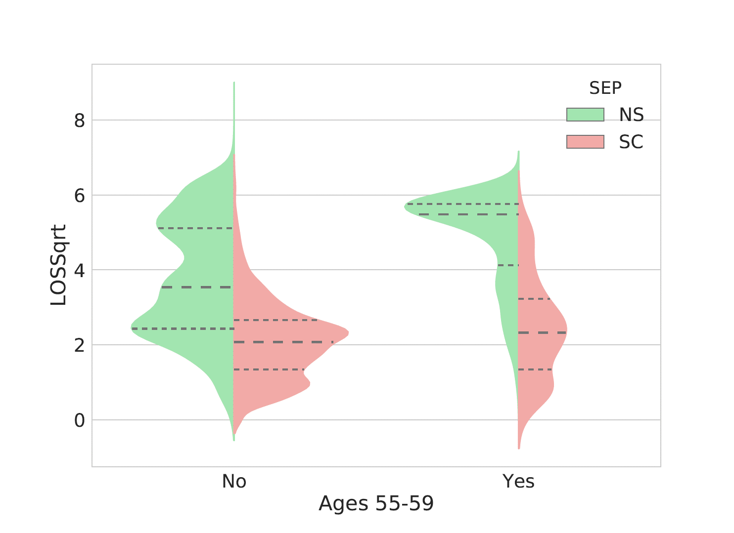
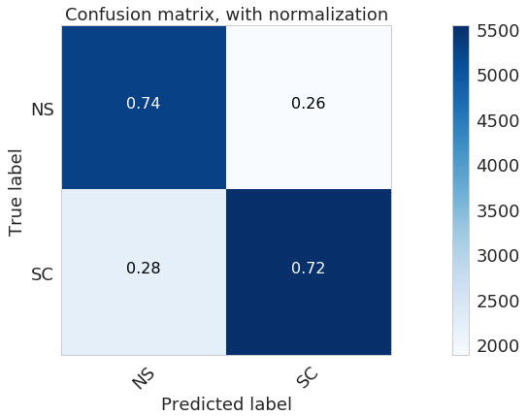
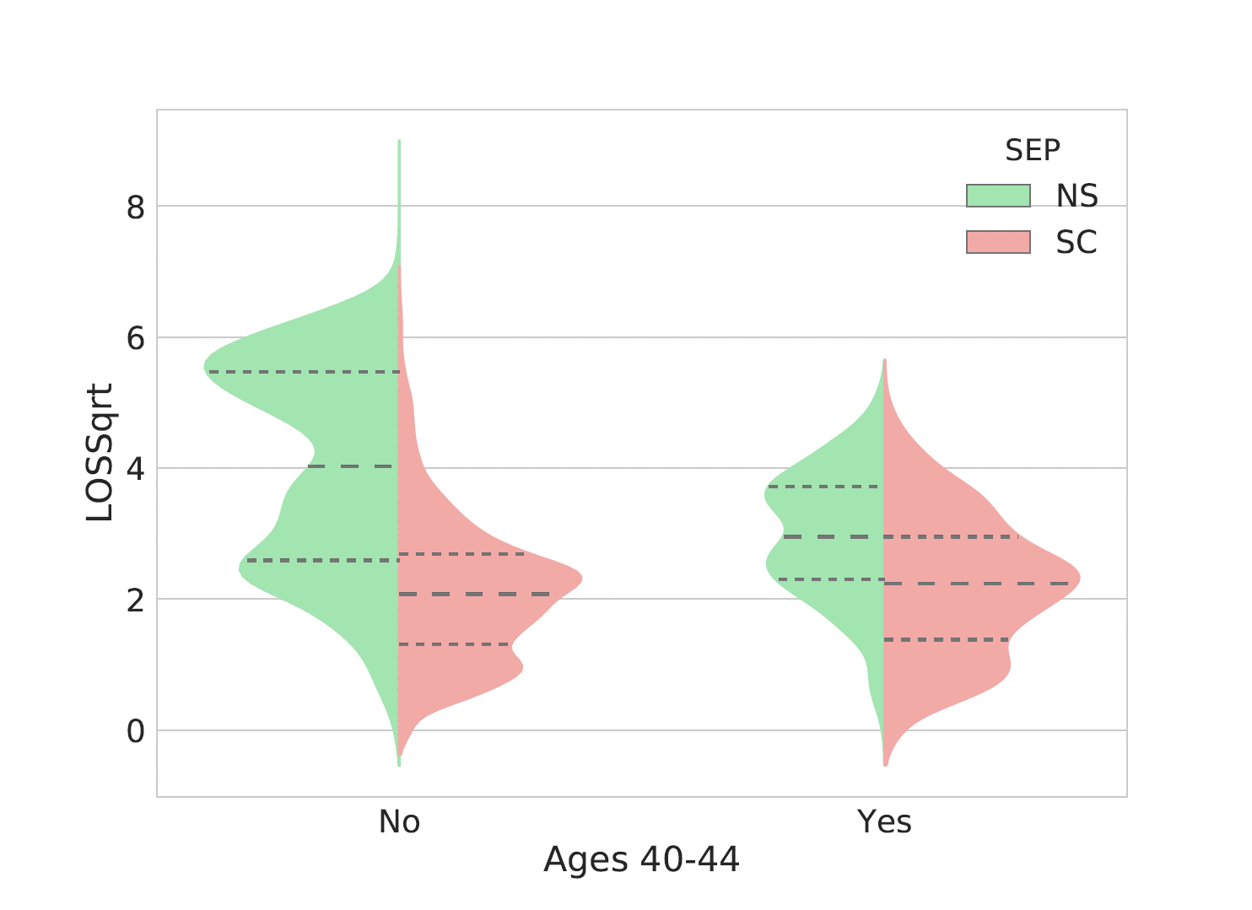
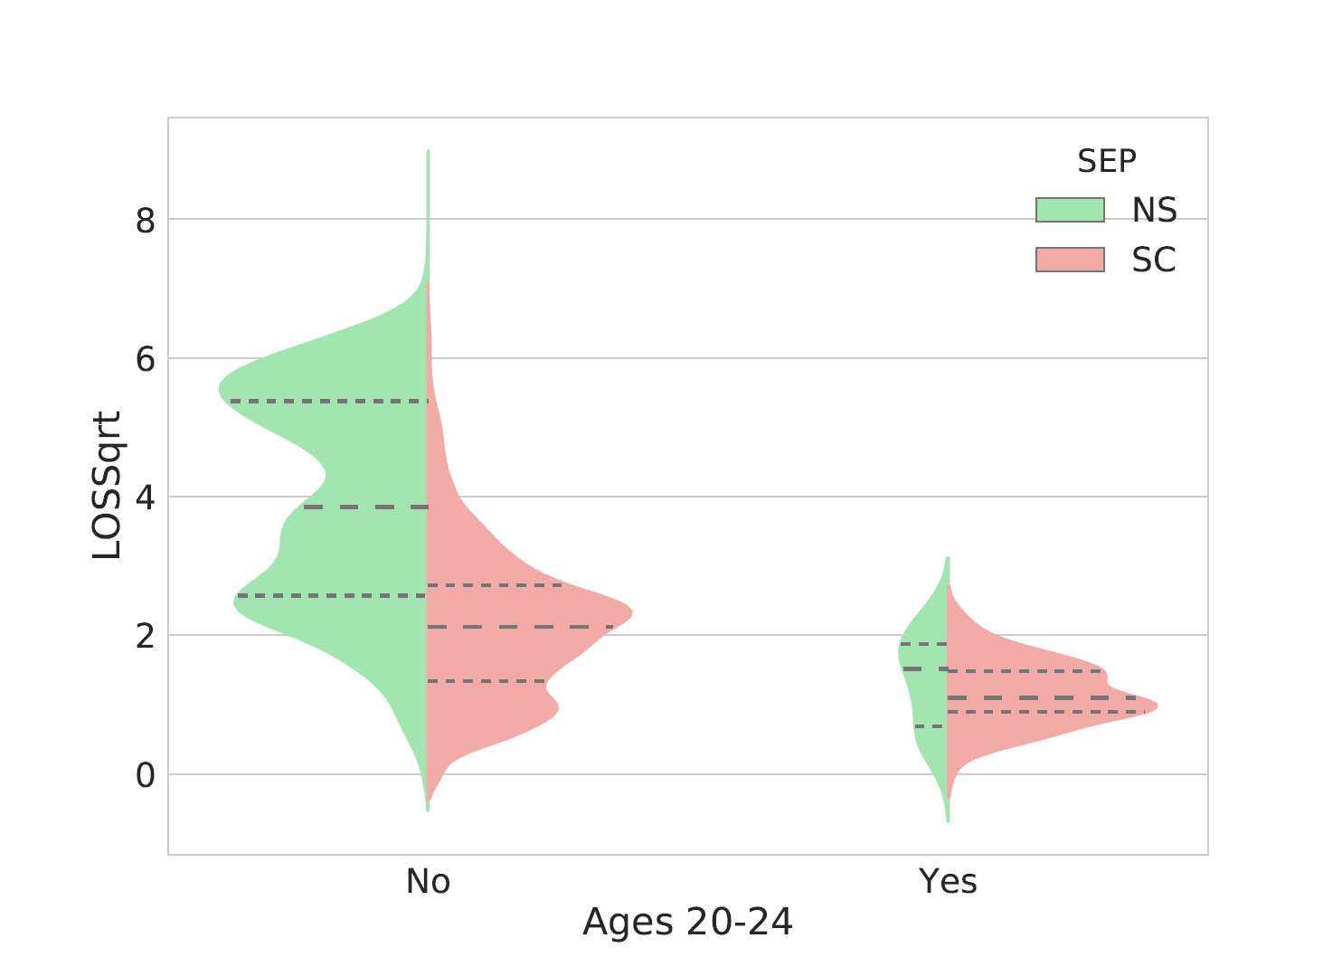
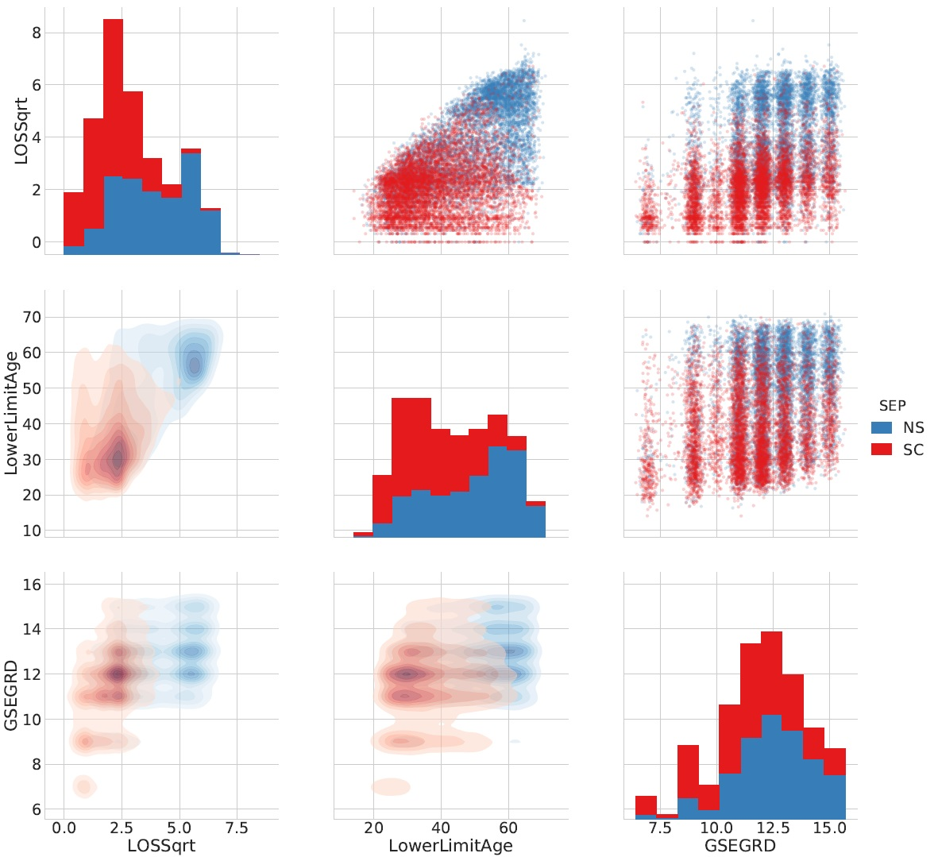
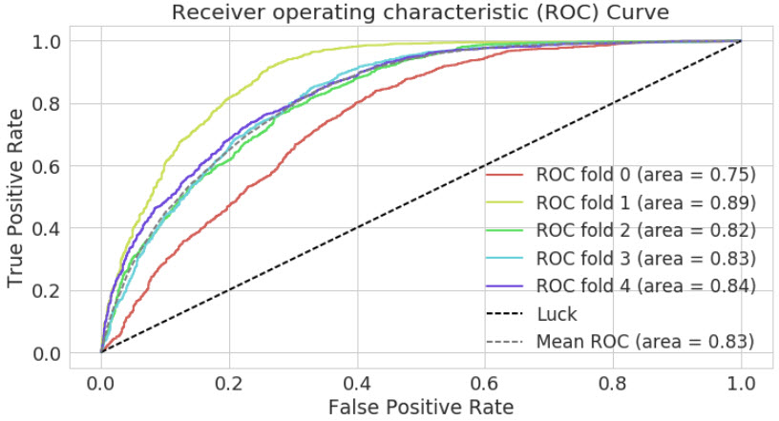

Employee Attrition: What Makes an Employee Quit?
Christopher Boomhower, Stacey Fabricant, Alex Frye, David Mumford, Michael Smith, Lindsay Vitovsky
Master of Science in Data Science
Southern Methodist University, Dallas, TX 75275, USA
DataScience@SMU
Introduction
Feature Sign. & Admin Predictions
Employee attrition is a costly challenge faced by employers
Separated Employees may cost up to 213% annual salary to replace [5].
Significant Features:
Length of Service
Age
General Schedule Grade
Various Locations
BLS Job Openings
Admin Predictions: 72.94% Accuracy
Problem
We present a model for predicting employee attrition, as well as discuss the ethical implications of using such a model within organizations.
Data Sources:
Office of Personnel Management (OPM) [22]
The Bureau of Labor Statistics (BLS) [15]
IBM Watson Analytics [4]
Model focus:
Train Professional Occupations
Test Administrative Occupations with final model
Ethical Considerations
Ethical Dilemmas:
Discriminatory Hiring Practices
Exploitive/Reductive Policy Making
Ethical Solutions:
Begin a dialog with attrition-likely individuals
Build out support within HR for groups within high-risk attrition segments
Analysis & Results
Conclusions
Primary separation types of interest
Non-Separation (NS)
Quits (SC)
Transfers & Retirements combined with Non-Separation & uncontrollable types dropped
7,500 observations per separation type
Feature selection critical – 99 dimensions
Manual Selection reduced to 32 dimensions
Areas for additional research include:
Location through Income Inflation margins
Raw Age Values
Employee Benefit Data
Attrition data with no pension set aside
Consider who stands to benefit from implementation
Used diligently, model may align to improve profitability, while aligning goals with employees
References
Model Version | Mean Accuracy (5 folds)
Logistic Regression: Manual Selection | 74.595%
Random Forrest: Manual Selection | 74.119%
KNN (kd-tree): Full Attribute List | 73.04%
Random Forest: Top 15 PC Loadings | 72.658%
4. IBMWatson Analytics. Sample Data: HR Employee Attrition and Performance." In: (September 2015). url: https://tinyurl.com/hnqdblc.
5. H. Boushey and S. J. Glenn. There are Signicant Costs to Replacing Employees". In: (November 2012). url: https://tinyurl.com/gv7o9y3.
15. Bureau of Labor Statistics. Help Tutorials: Data Descriptions". In: (November 2002). url: https://tinyurl.com/ybg2whaf. 22. Office of Personnel Management. 'Separations Data' from 'Data, Analysis and Documentation'". In: (2016). url: https://tinyurl.com/y9qy8pw2.
Notes:
Table Accuracies on side
ROC on side
Coefficients in middle
Scatter in Middle
Violin in middle if fit [age or paygrp]
Confusion matrix on right side

